Slide 1
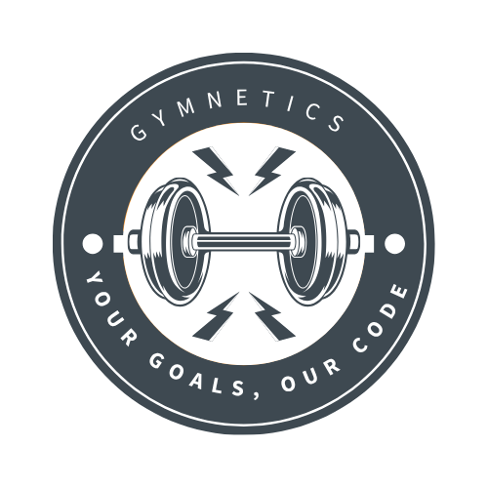
Gymnetics Sprint 0
Team Byte Squad

Slide 2
CONTENTS
Meet Gymnetic | Introduction to Gymnetics team members and their roles.
Problem | Addressing the problem Gymnetics aims to solve.
Product Overview | Exploring product goals and features.
Target Demographic | Identifying the primary users that Gymnetics would resonate with.
Personas | Displaying description of users and showcasing their use case.
Benefits | Key solutions to the problem discussed previously.
Tech Stack | Technologies used to build Gymnetics.
MVP | Outline of the Minimum Viable Product (MVP).
Timeline | Estimated product schedule with milestones.

Slide 3
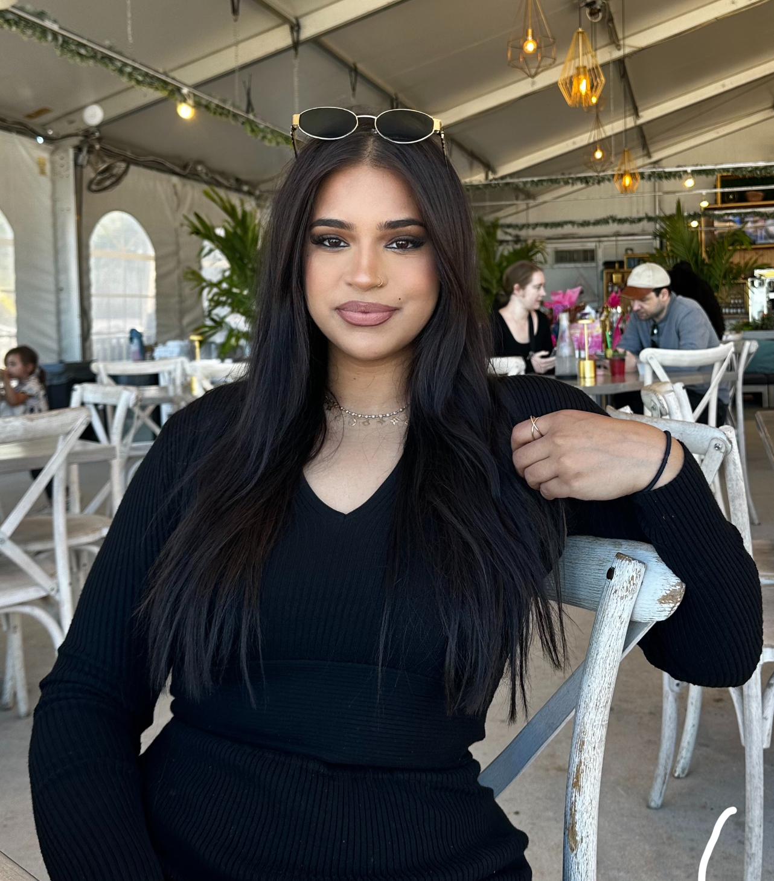

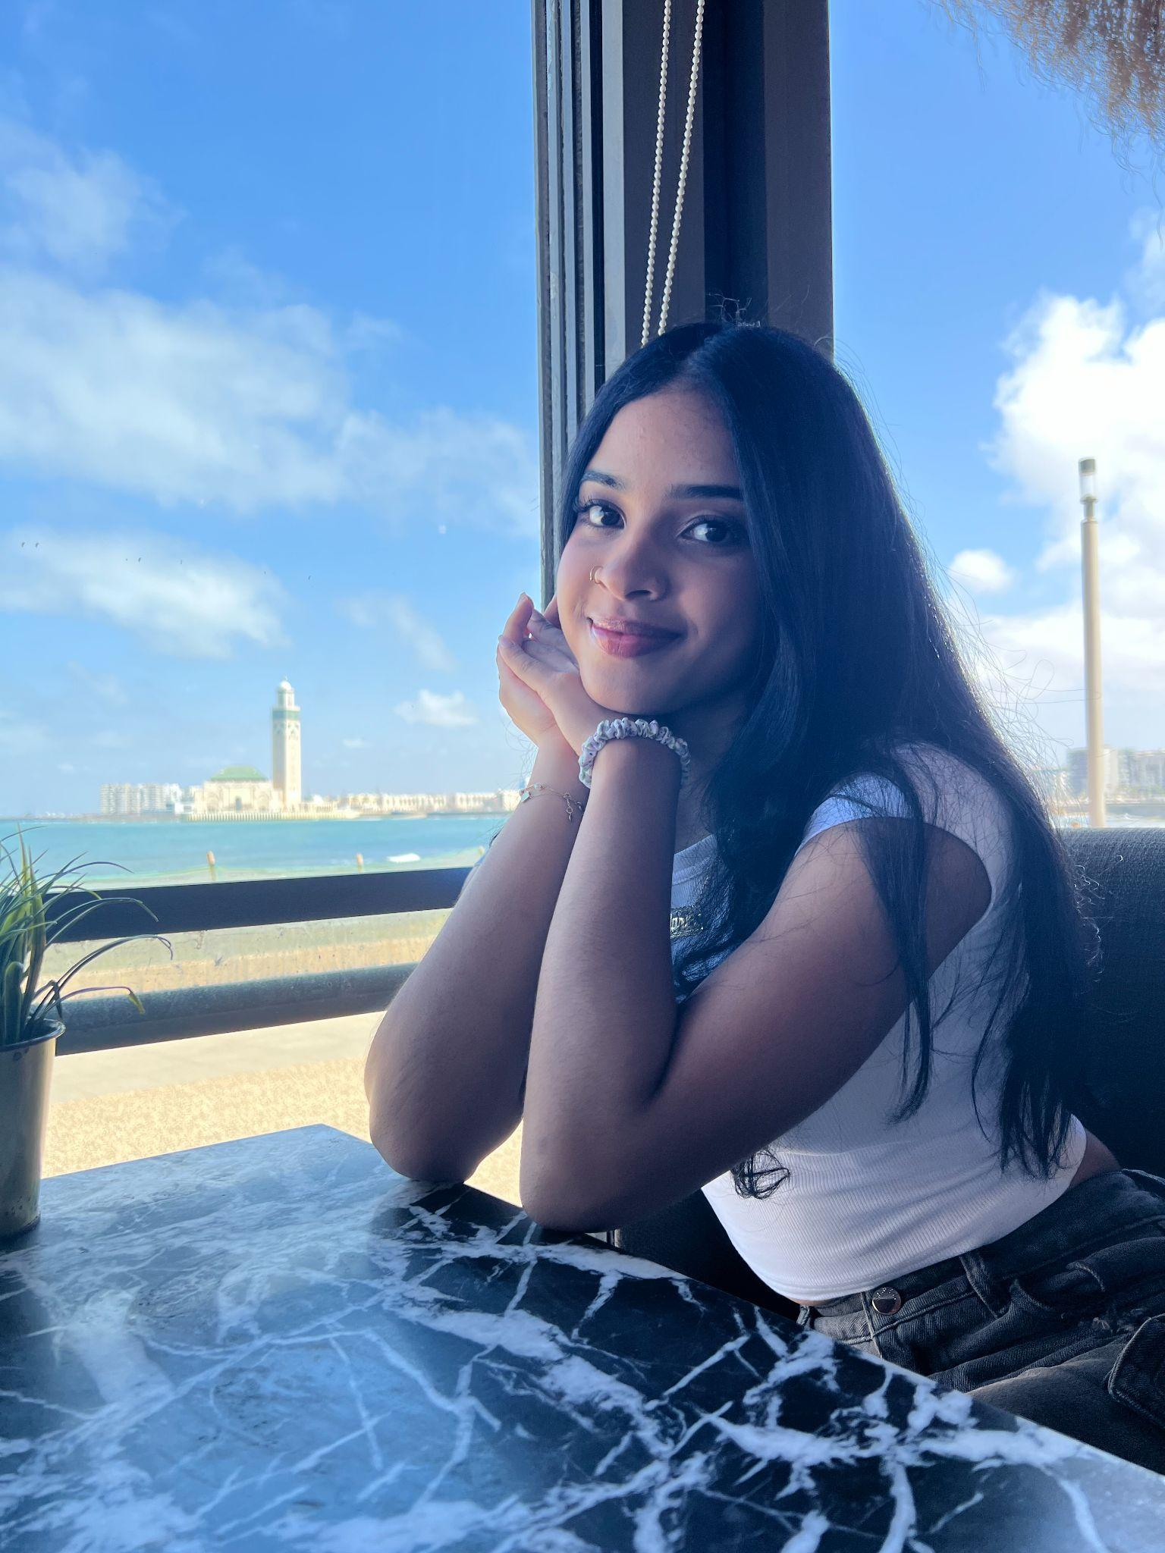
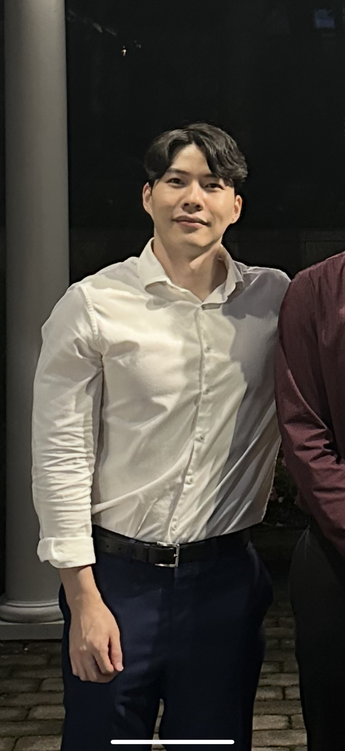
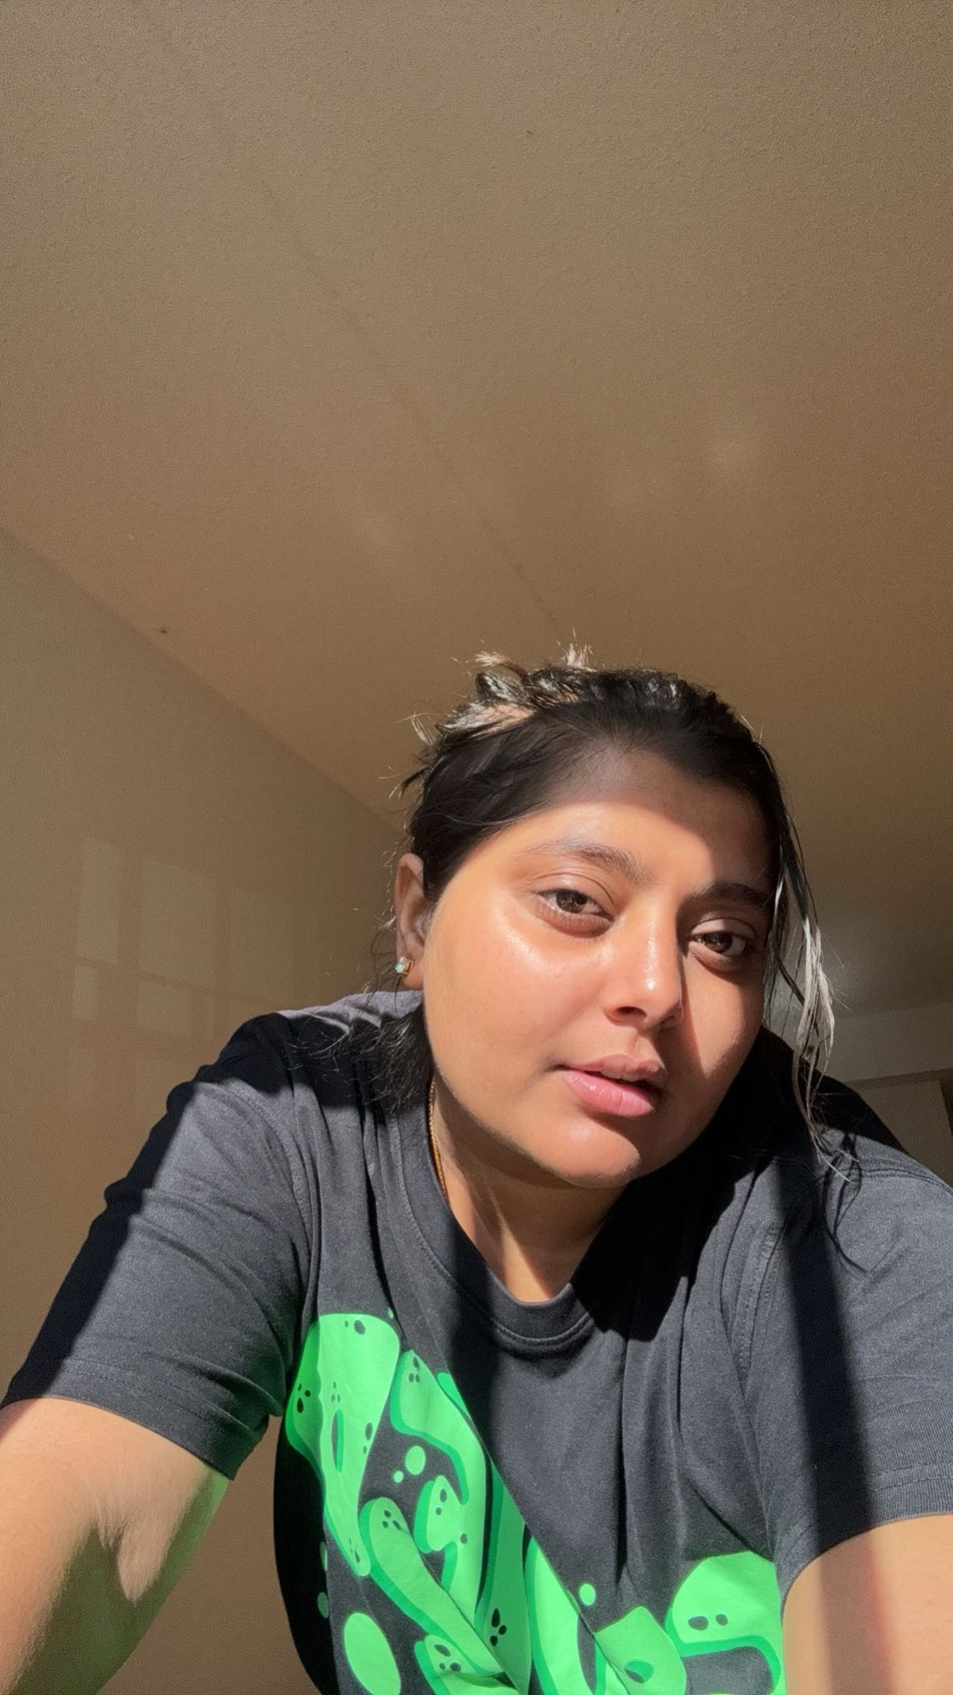
Meet the Gymnetics
Samiha Shareef
Adam Miftahelidrissi
Marlen Cuevas Duarte
Jia Lau
Diya Ashish Patel

Slide 4

Problem
Consumers feel overwhelmed by the number of supplement options and don’t know what’s right for them.
Shoppers often buy products they don’t actually need, leading to waste or potential harm.
Many people aren’t sure which store is reliable, affordable, or has the most effective products

Slide 5

Product Overview
Gymnetics is an AI-powered supplement store that provides personalized recommendations based on each user's fitness data. By analyzing information such as height, weight, age, and other relevant metrics, Gymnetic suggests supplements from our store tailored to the user's individual needs—focusing on what their body may be lacking to help them reach their fitness goals more effectively. Machine learning techniques will be used to personalize fitness and nutritional intake.

Slide 6
Benefits
Individualized supplement recommendations -No more stressing about what to buy. Based on your goals and statistics, our platform makes customized suggestions for you.
Spending more effectively- Customers are not going to waste cash on unnecessary extras that don't help their goals.
Encourages consistency- Reminders to record meals and follow your plan make it simpler to stay on course.
Keeps up with developments throughout your journey-Our recommendations will adapt to your evolving fitness objectives. It is designed to keep growing with you.
Reduces stress-Purchasing supplements is more accessible and not as intimidating.

Slide 7
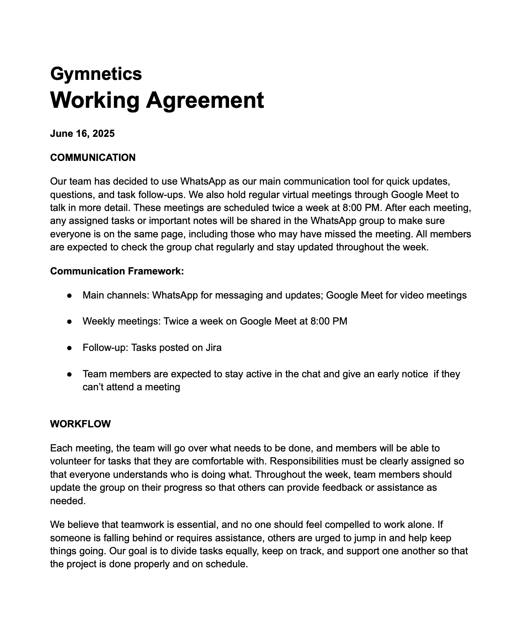
Working Agreement Overview

Slide 8
Demographic/Audience
Our target audience:
Young adults (18–30) and college students attempting to keep up with employment, school, and fitness.
Beginners who are confused about where to begin using supplements or who feel lost in the gym.
Intermediate lifters who are prepared to engage in more serious activities (such as bulking or competing).
What they are looking for:
A detailed plan for healthy nutrition and exercise.
Reliable suggestions they can completely rely on.
A method for maintaining motivation, accountability and consistency
Why Gymnetics?:
It helps customers reach their fitness objectives without the need for a personal trainer, saves time, and clears up any uncertainties a user may have.

Slide 9
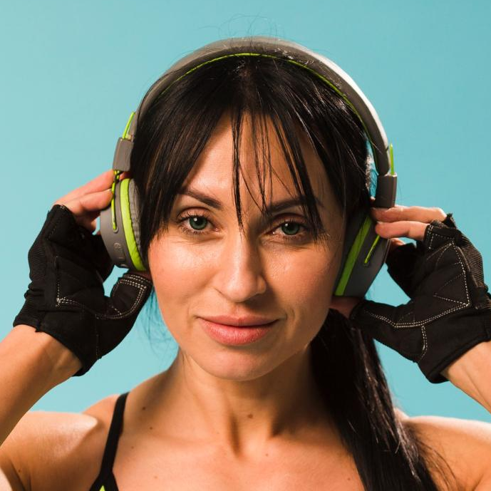
PERSONA 1 - UNORGANIZED STUDENT
“I WANT TO LEAD A HEALTHIER LIFESTYLE WITHOUT EXTREME DIETING AND EXERCISE. I WANT TO BE CONSISTENT AND DISCIPLINED.”
GOALS
1
Build Lean Muscle Mass
2
Learn How to Weightlift
MARIA CASTRO
DETAILS
Eat Consistent & Healthy Meals
3
20 years old
5’5”, 135lbs
Full time student & part -time Bookkeeper
EXPERIENCE
PAIN POINTS
Beginner - only familiar with at home bodyweight workouts
Has only been to the gym a handful of times, inconsistent with workouts & getting enough meals in the day. Doesn’t know what to eat.
** Maria will input all her information (age, weight, height, and goals) and receive a 3 day workout split, macro breakdown, and supplement suggestions. She will receive reminders to log in her meals. The suggestions from the store will be daily multivitamins,creatine, and whey isolate or plant-based protein powders.

Slide 10
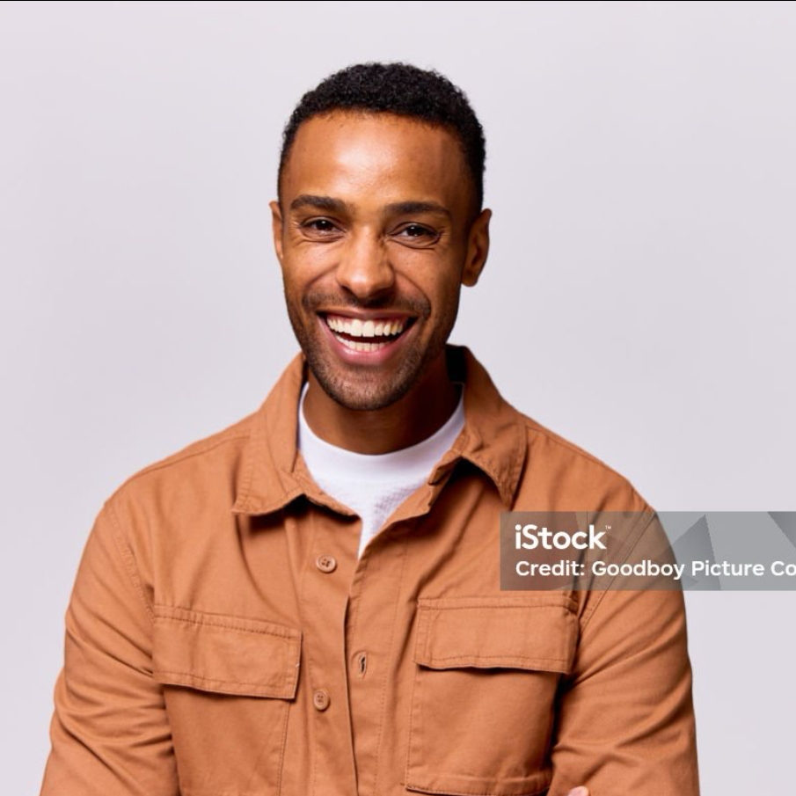
PERSONA 2 - AMATEUR BODYBUILDER
“I WANT TO BECOME A BODYBUILDER AND JOIN MY FIRST COMPETITION THIS YEAR. ”
MOTIVATIONS
1
Build Muscle Mass & Strength
2
Join bodybuilding competition
JAMES BROWN
DETAILS
Reach 210 lbs
3
28 years old
6’2”, 178 lbs
Retail Sales Associate
EXPERIENCE
PAIN POINTS
Intermediate - lifts often but doesn’t keep track of his nutrition & weight
Doesn’t have a consistent workout split, doesn’t know how to track macros & calories, not familiar with supplements
** James will input all his information (age, weight, height, and goals) and receive a 5 day workout split, macro breakdown, and supplement suggestions. The suggestions will be creatine, pre workout, mass gainer, fish oil , and whey isolate or whey blend protein powders.

Slide 11
What is MVP?
The Minimum Viable Product (MVP) is the simplest version of our app that delivers core value to users.
For Gymnetic, the MVP means:
- Basic user login and registration
- Personalized profile setup (height, weight, goals)
- Viewing a supplement store
- Adding items to cart
- Mock checkout (no real payments)
- Personalized fitness plan and nutritional recommendations
This allows users to experience our fitness ecosystem from Day 1!

Slide 12
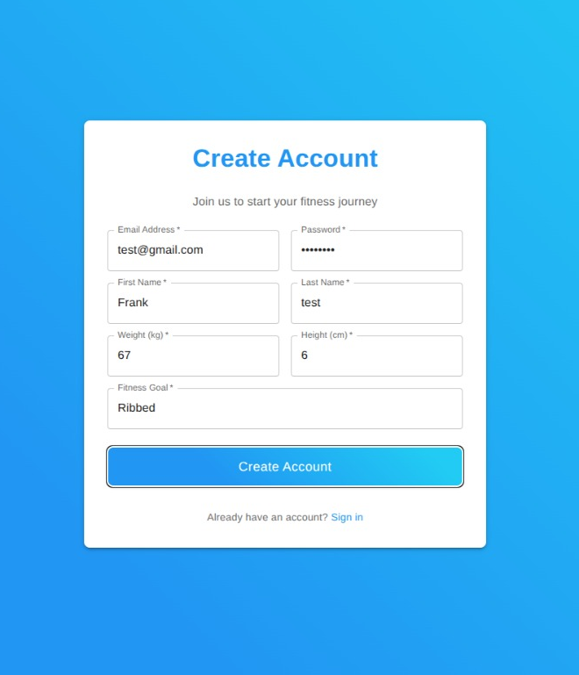
CREATING AN ACCOUNT
A first time user registers their account on the app before signing in.
Once inside the app, a user can navigate to a supplements store where they can select items on the screen and add them to a cart.
Once satisfied they open the cart and pay the online checkout.

Slide 13
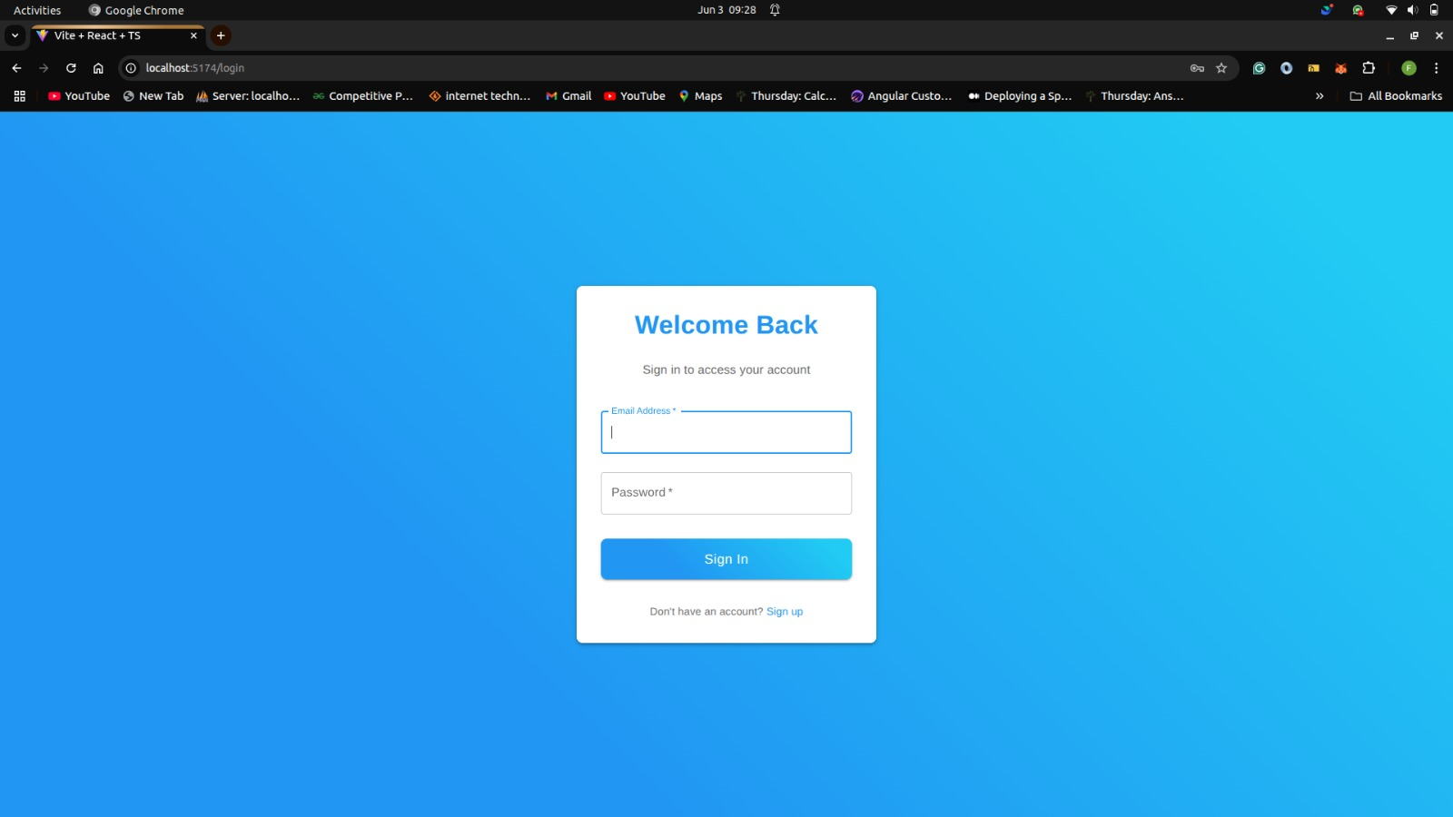
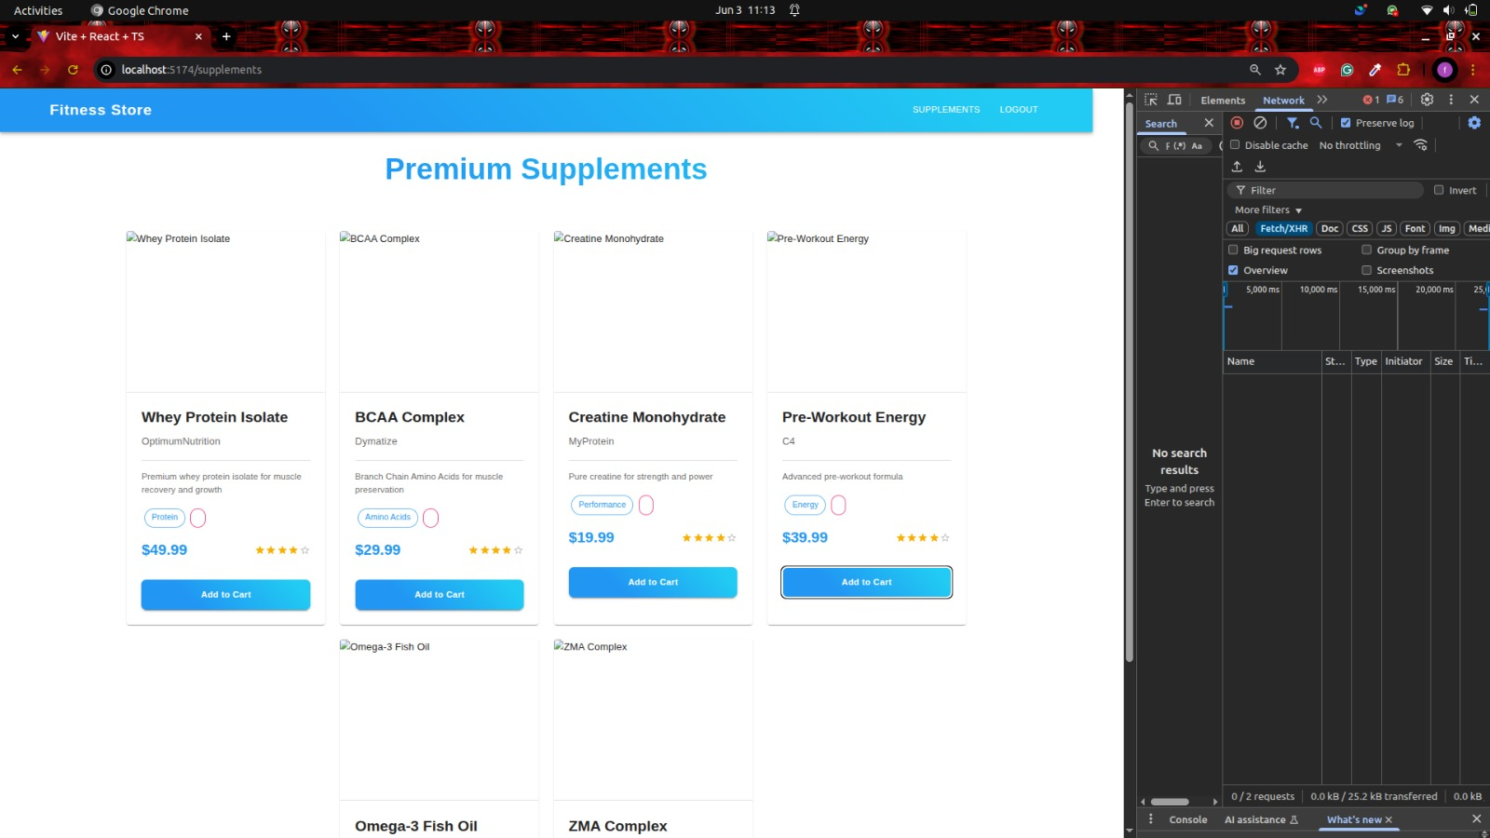
SIGNING IN
SUPPLEMENTS STORE

Slide 14
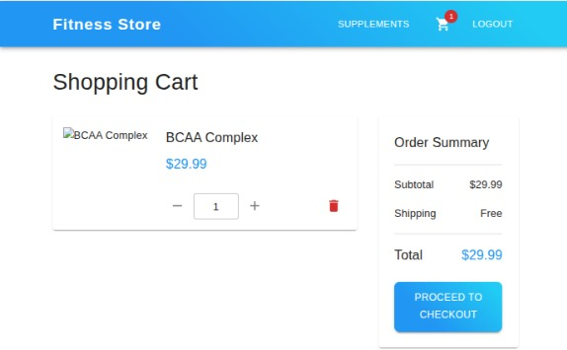
CHECKOUT

Slide 15
Gymnetic MVP Features
✔️ User Sign-up/Login
✔️ Profile: Add height, weight, fitness goals
✔️ Browse Supplements Store
✔️ Add to Cart
✔️ Mock Checkout (no payment yet)
✔️ Simple Trainer Dashboard
✔️ Customized workouts and nutritional recommendations

Slide 16
Tech Stack
Backend
Java
Spring Boot
AI Integration
Deepseek
Frontend
React
CSS
HTML
Database
MySQL
Third Party
Docker
AWS S3
Stripe

Slide 17
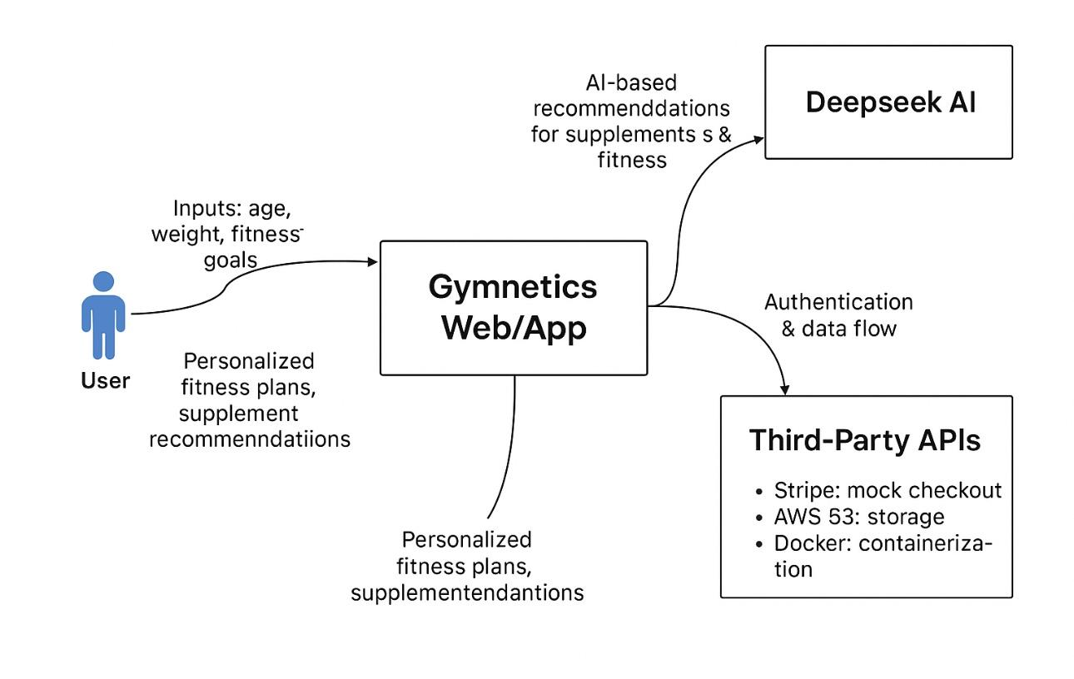
Context Diagram

Slide 18
Timeline
INITIATIVE | OBJECTIVE | May 22 | June 11 | July 9 | July 31 | Aug 22
Sprint 0 | Develop a business application, personas, a schedule. Record presentation and retrospective. Introduce the MVP.
Sprint 1 | Develop user stories with acceptance criteria, test cases, and backlogs. Record retrospective and sprint planning.
Sprint 2 Part 1 | Continue developing user stories with acceptance criteria, test cases, and backlogs. Record retrospective and sprint planning.
Sprint 2 Part 2 | Present the functional MVP with minimal usable features. Present more stories and build on top of this MVP. Record a final retrospective and sprint planning.

Slide 19
Retrospective
Chose an AI centered supplement store platform to help with personalized fitness and nutrition support.
Product aligned with the team’s interest in fitness, health, and AI technology.
Weekly check-ins were made to stay on track and align tasks effectively.
Completed the requirements of an MVP, target demographic, problem we are solving, as well as the tech stack we will be moving forward with.
Next steps would be to start the sprint 1 as written in the timeline.

Slide 20
THANK YOU
https://github.com/htmw/2025Su-ByteSquad/wiki

